Slide 1

IBM SkillsBuild for Adult Learners - Data Analytics
Data Analytics Internship Program 2024
Final Project Presentation
Project Name: Flood Analysis & Prediction
Unique ID : IBM1688
Team Name : Data Squad
College Name: Guru Jambheshwar University of
Science & Technology, Hisar

Slide 2




Meet The Member of Team Data Squad
ABHAY KUMAR
SANOJ KUMAR
ANKIT KUMAR
KIRTI SINHA
Member
Member
Member
Member

Slide 3

Introduction
This project aims to leverage data analysis and linear regression techniques to analyze historical flood data and predict future flood events. By identifying patterns and relationships in the data, the project seeks to provide actionable insights for early warning systems and disaster preparedness.

Slide 4

OBJECTIVE
01
Data Collection and Preprocessing:
02
03
Feature Engineering:
Model Development:
Gather and preprocess relevant data sets that influence flood occurrences, such as precipitation levels, river discharge rates, soil moisture content, and historical flood records.
Identify and select significant features that contribute to flooding, transforming raw data into meaningful inputs for the predictive model.
Build and train a linear regression model using historical flood data to predict future flood events.
04
05
Validation and Testing:
Visualization and Reporting:
Validate the model's accuracy using various statistical metrics and test its predictive capabilities on unseen data.
Develop visualization tools and reports to communicate the model's predictions and insights to stakeholders, including disaster management authorities and local communities.

Slide 5

PROBLEM IDENTIFICATION
PROBLEM STATEMENT
SIGNIFICANCE OF PROBLEM
Flooding poses a severe threat to communities worldwide, leading to devastating consequences. Despite advancements in technology and meteorology, accurately predicting flood events remains challenging due to the complex interplay of various climatic and environmental factors.
This project addresses the need for a more reliable and data-driven approach to flood prediction, focusing on linear regression to model and forecast flood occurrences based on historical data and relevant predictors.
Accurately predicting floods is crucial for minimizing economic losses, environmental damage, and human casualties. Traditional methods often fall short, necessitating advanced data-driven approaches.
This project aims to enhance flood prediction accuracy, supporting better disaster preparedness, early warning systems, and informed policy decisions, ultimately safeguarding communities and resources.

Slide 6


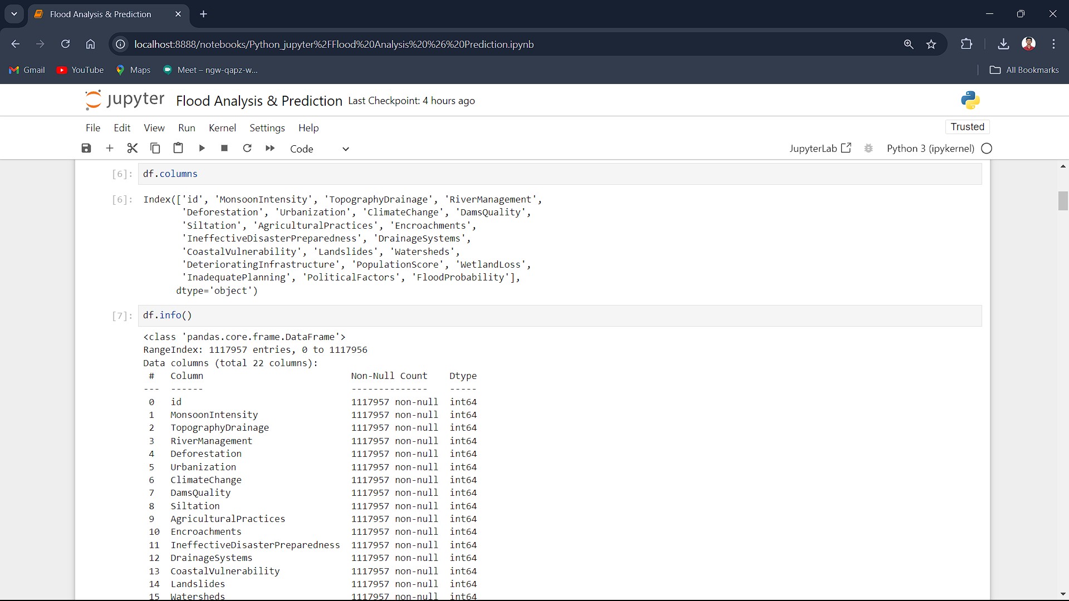
Data Collection
1
Data Sources
The dataset used in this project is taken from Kaggle. There are several attributes in the data set on which we are analyzing, visualizing and predicting the flood
2
Data Description
This dataset contains information on various factors that may influence flood risk. The dataset includes several features representing environmental, social, infrastructure, and governance-related factors that could impact the likelihood and severity of flooding events.

Slide 7


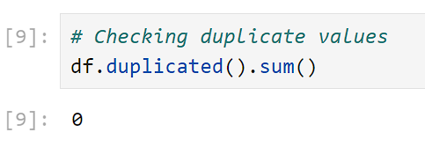
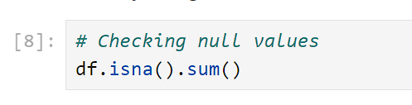
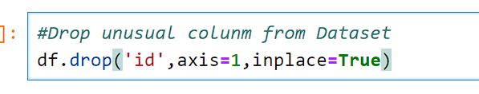
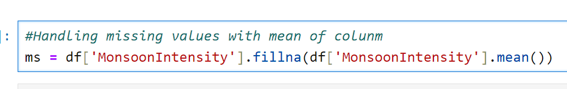
Data Preprocessing
Handling Missing Values
Data Cleaning
For Data cleaning first we have check null and duplicate values present in dataset by df.isna().sum() & df.duplicated().sum() function.
And remove the unusable column by df.drop('id',axis=1,inplace=True) method
Missing values is replace by the mean value of column
We have used method df['MonsoonIntensity'].fillna(df['MonsoonIntensity'].mean()) to handle the missing values with mean value.

Slide 8

Data Analysis
Analytical Tools and Methods Used:
Python: For data preprocessing, feature engineering, and model development using libraries such as Pandas, NumPy, Scikit-learn, seaborn and matplotlib.
Key Findings:
Select significant features based on domain knowledge and statistical tests.
Create new features through transformation, aggregation, and interaction terms.
Insights Derived:
Conduct EDA to understand the distribution and relationships between variables.
Visualize data using charts, graphs, and heatmaps to identify patterns and trends.

Slide 9
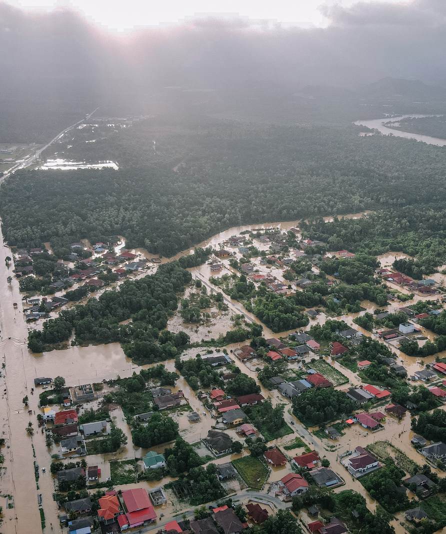
Hypothesis Development
Formulated Hypothesis:
The hypothesis for this project is that key environmental and climatic variables such as 'MonsoonIntensity', 'TopographyDrainage', 'RiverManagement', 'Deforestation', 'ClimateChange', 'DamsQuality',
'Siltation','DrainageSystems', 'Landslides', 'Watersheds', 'WetlandLoss data can be used to accurately predict future flood events using a linear regression model.
Method for Testing the Hypothesis:
The hypothesis will be tested through the following steps:
Data Collection and Preprocessing
Feature Selection and Engineering
Model Development and Training
Model Validation and Testing
Visualization and Reporting

Slide 10
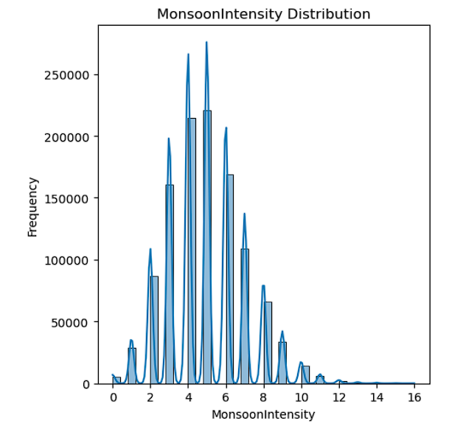
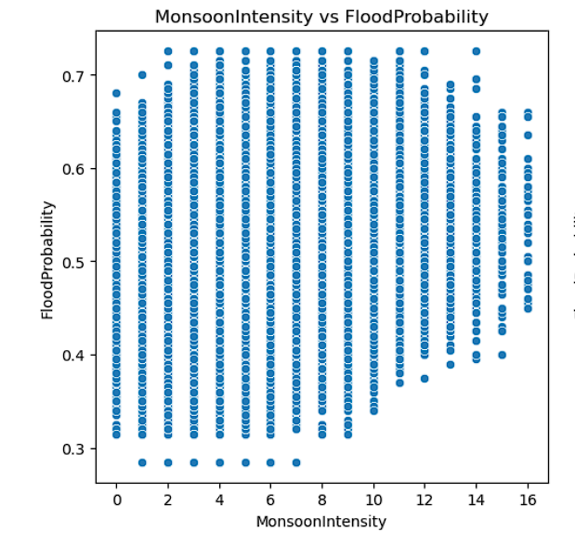
Data Visualization
Data visualization helps in identification of significant factors contributing to flooding and their relative importance.
Histogram Distribution of Flood Dataset
Scatter plot of Flood Dataset

Slide 11
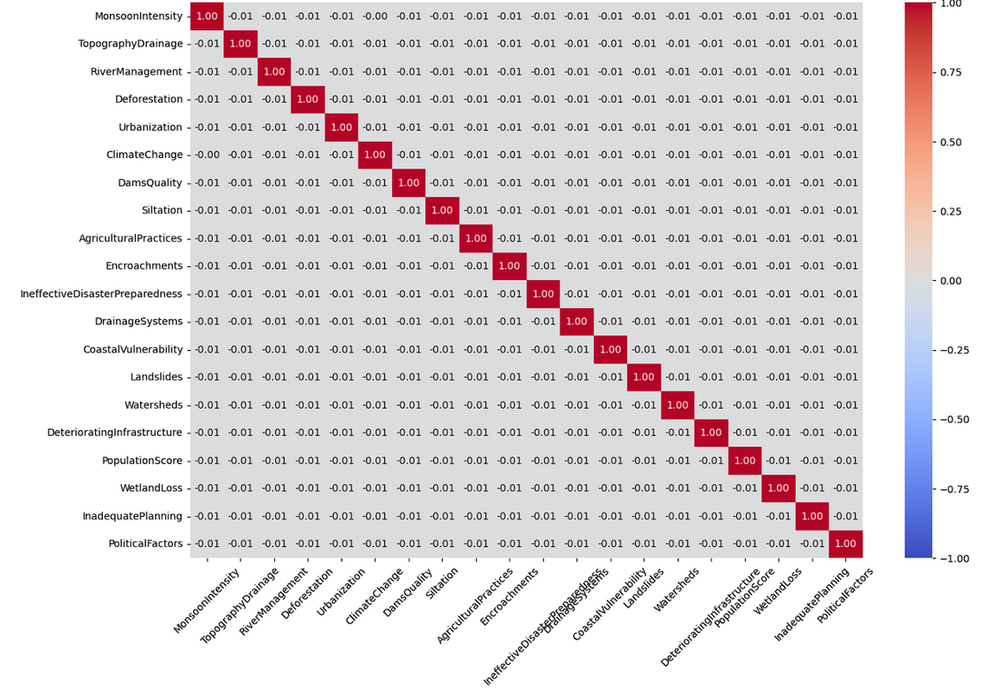
Visualization
Correlation Matrix Analysis
This correlation matrix heatmap illustrates the relationships between various factors and the probability of flooding. Each cell in the matrix shows the correlation coefficient between two variables, ranging from -1 to 1. A value closer to 1 indicates a strong positive correlation, meaning as one variable increases, the other tends to increase. Conversely, a value closer to -1 indicates a strong negative correlation, where one variable increases as the other decreases. Values around 0 suggest little to no linear relationship.
Correlation Plot
High positive correlation
Negative correlation
Insights for Model Building
with FloodProbability: Certain factors, such as [mention any specific factors with high correlation], show a strong positive correlation, indicating that these factors significantly contribute to increased flood probabilities.
Some factors may show a negative correlation with flood probabilities, suggesting a decrease in flooding likelihood as these factors increase.
Understanding these correlations helps in selecting relevant features and understanding their impact on the target variable, guiding model development and analysis.

Slide 12

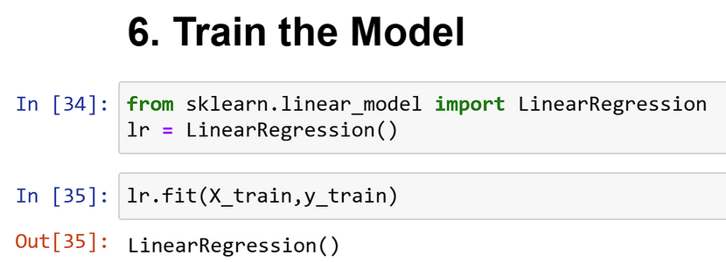
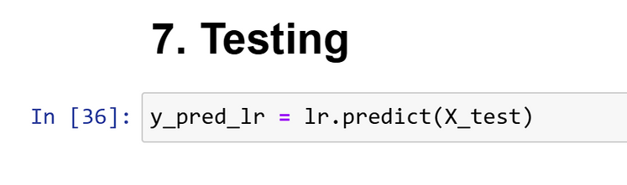
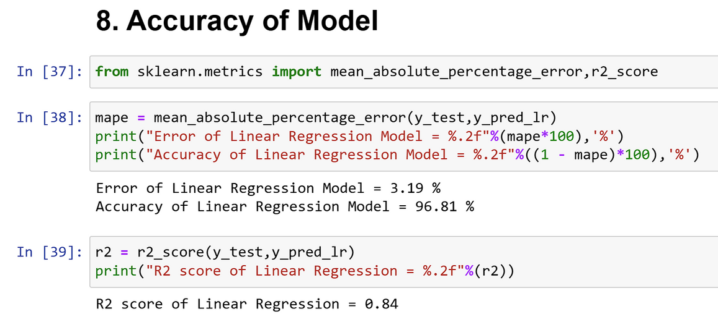

Model Building
Train the Model
We used the Linear Regression algorithm from the sklearn library to train our model. The model was trained on the training dataset, using various predictors that potentially influence flood probabilities.
Testing
After training, the model was tested on the test dataset to evaluate its predictive performance. The predictions (y_pred_lr) were generated based on the features from the test set.
Accuracy of Model
The model's accuracy was assessed using the Mean Absolute Percentage Error (MAPE) and the R² score. The MAPE indicated a relatively low error rate of 3.19%, suggesting that the predictions were generally close to the actual values. The R² score of 0.84 reflects a strong correlation between the predicted and actual values, indicating that the model explains 84% of the variance in the flood probability.

Slide 13
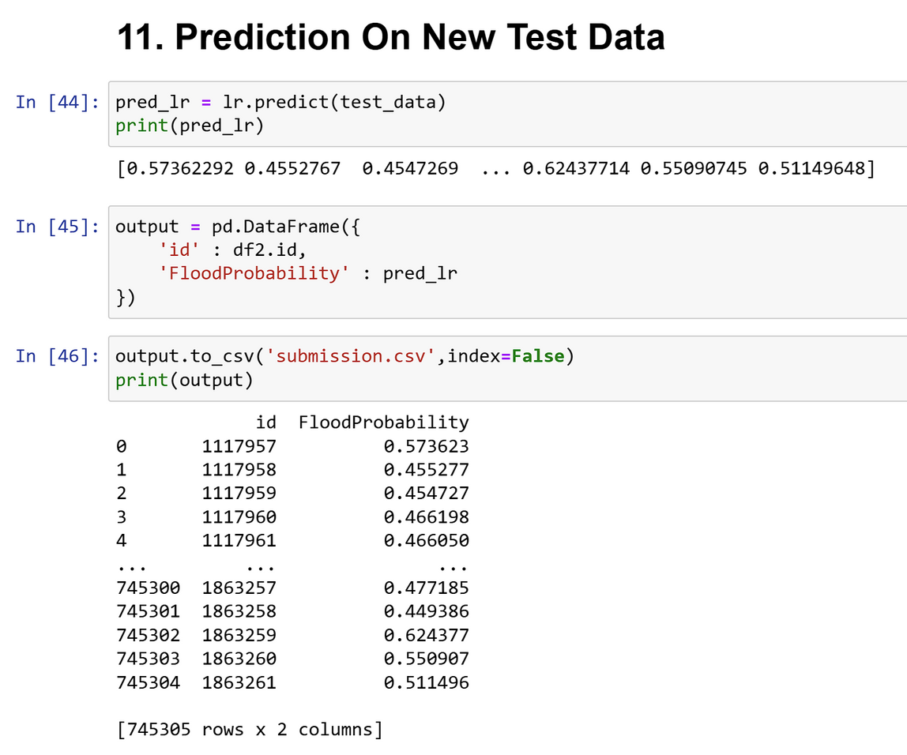

Model Predictions
Prediction on New Test Data
In this step, the trained Linear Regression model was used to predict flood probabilities for new test data. The model generates a probability score for each record, indicating the likelihood of flooding.
The output predictions were saved in a CSV file (submission.csv) with two columns: id and FloodProbability. Each row represents an individual record with a unique ID and its corresponding predicted flood probability.
Advantages of the Predictions:
Proactive Disaster Management
Resource Allocation
Insurance and Financial Planning
Urban Planning and Infrastructure Development
Public Awareness and Preparedness

Slide 14
Problem Outcomes
Accurate Predictive Model: A linear regression model capable of accurately predicting flood events based on historical data and key predictors.
Insightful Analysis: Identification of significant factors contributing to flooding and their relative importance.
Visualization Tools: Interactive dashboards and visualizations to help stakeholders understand flood risks and take proactive measures.
Policy Recommendations: Data-driven recommendations for improving flood management strategies, infrastructure planning, and community preparedness.
Enhanced Early Warning Systems: Improved accuracy and reliability of flood predictions, enabling timely warnings and reducing the impact of floods on communities.

Slide 15
Conclusion
This project aims to leverage the power of data analysis and linear regression to address the critical issue of flood prediction. By developing an accurate and reliable predictive model, the project seeks to enhance early warning systems, inform policy decisions, and ultimately reduce the devastating impact of floods on human lives and the environment. Through rigorous data collection, analysis, and visualization, the project will provide valuable insights and tools for better flood management and preparedness.

Slide 16

References
Data Sources
The dataset used in this project is taken from Kaggle. There are several attributes in the data set on which we are analyzing, visualizing and predict flood probability.
https://www.kaggle.com/code/aspillai/flood-prediction-regression-lightgbm-0-86931?scriptVersionId=179612055
Tools & Software Used
Jupyter Notebooks: For documenting the analysis process and presenting results.
Python: For data preprocessing, feature engineering, and model development using libraries such as Pandas, NumPy, Scikit-learn, Seaborn and Matplotlib.
Additional References
We have used Canva and Microsoft Power point for presentation.

Slide 17
Thank you

